Slide 1
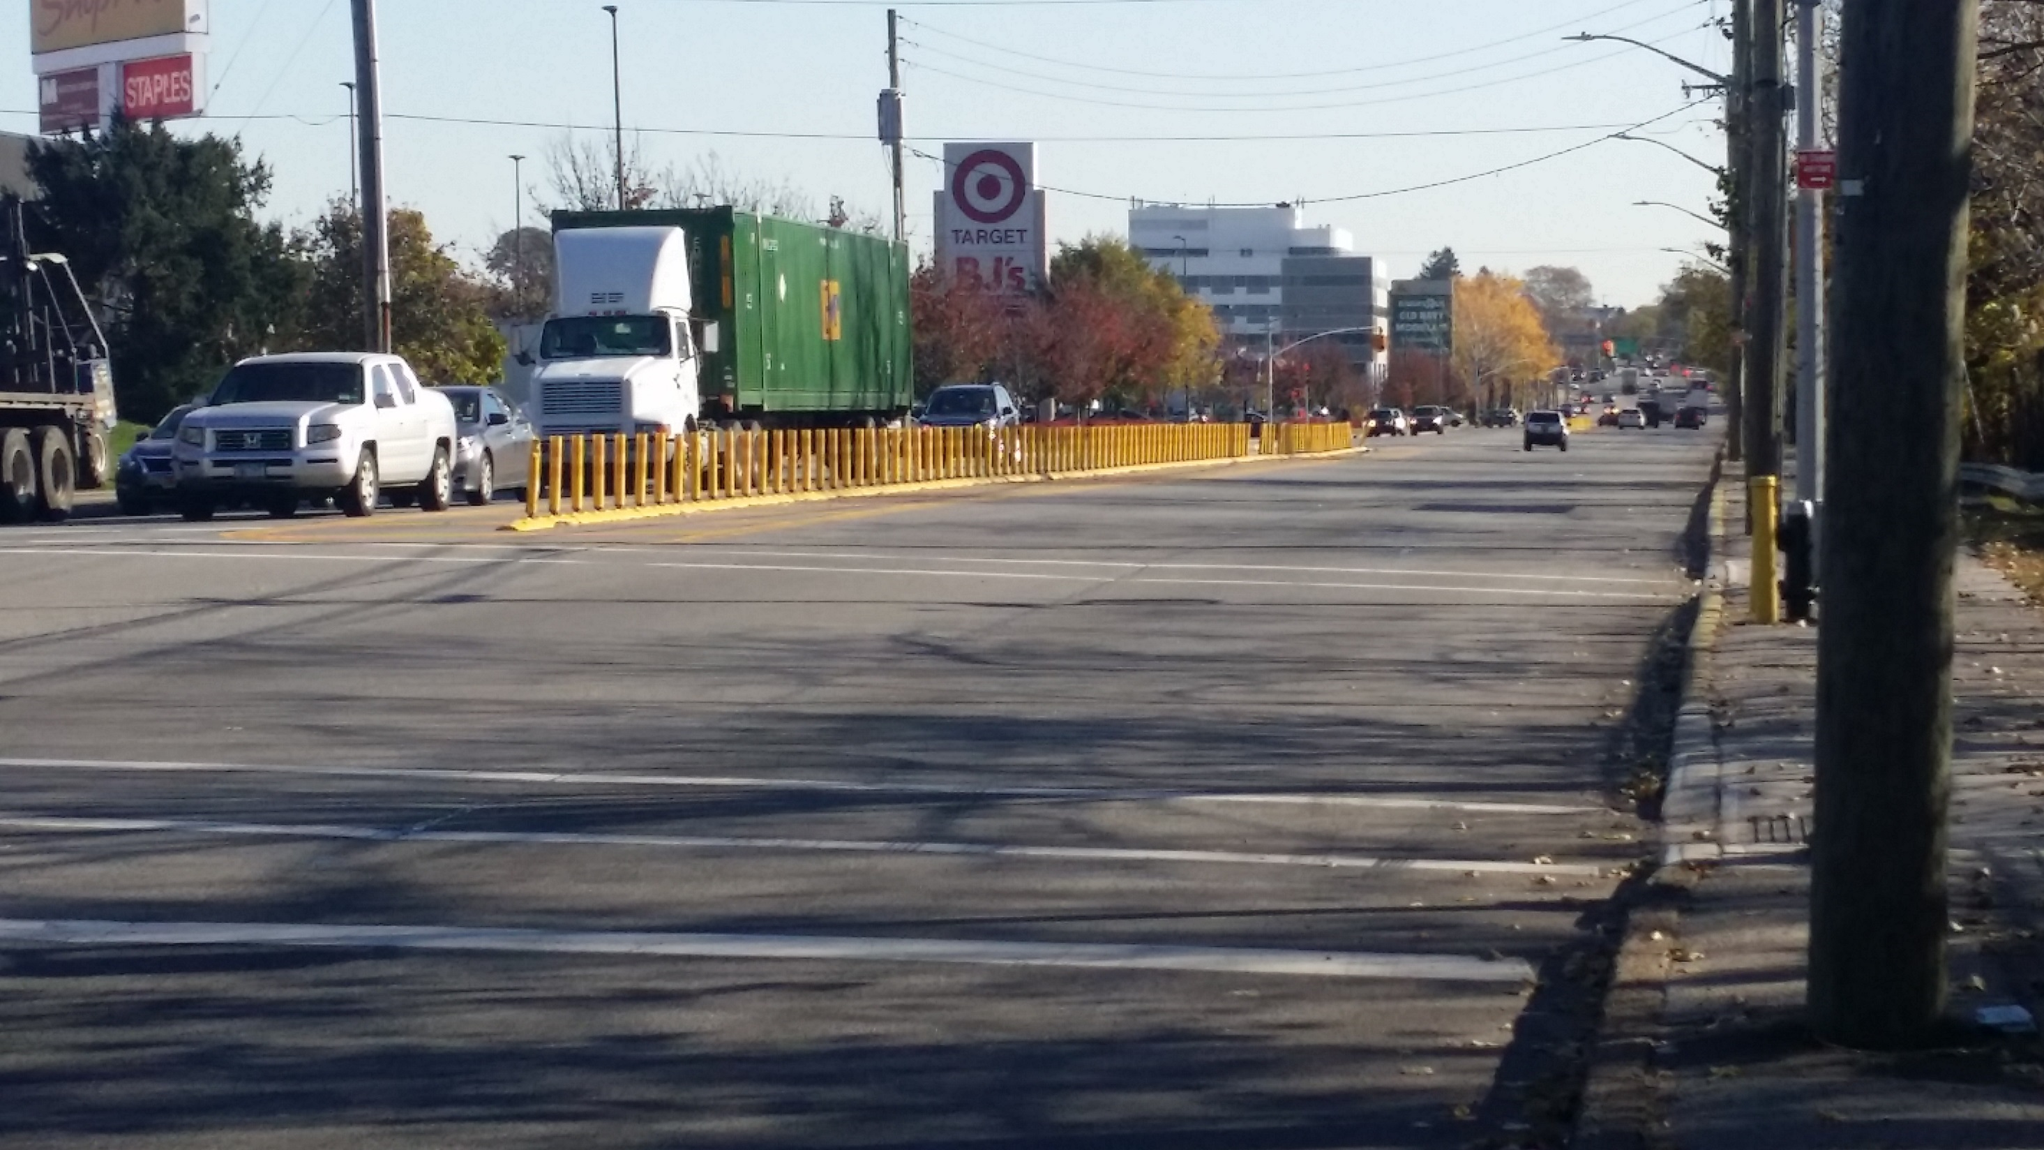


College Point Corporate Park Transportation Study
November 2017
| InGroup | Traffic Databank

Slide 2
Table of Contents
Study Context and Overview | 3
Transportation Analysis | 8
Transportation Recommendations | 16
Infrastructure Analysis | 25
Potential Infrastructure Solutions | 36
Appendix A – Community Outreach | 43
Appendix B – Detailed Transportation Analysis | 51
Appendix C – Geotechnical References | 93

Slide 3
Study Goals
Develop low-cost, readily-implementable short-term improvements
Develop longer-term improvements that require significantly greater capital investment and planning, but can provide more substantial transportation and infrastructure solutions
Concentrate on problem and opportunity corridors such as 20th Avenue, College Point Boulevard, Linden Place, Ulmer Street, and the Whitestone Expressway Service Roads
Focus on safety problems within the study area aligning with Citywide Vision Zero goals
Identify locations where street redesign and reconstruction may be warranted; identify proposed improvements

Slide 4
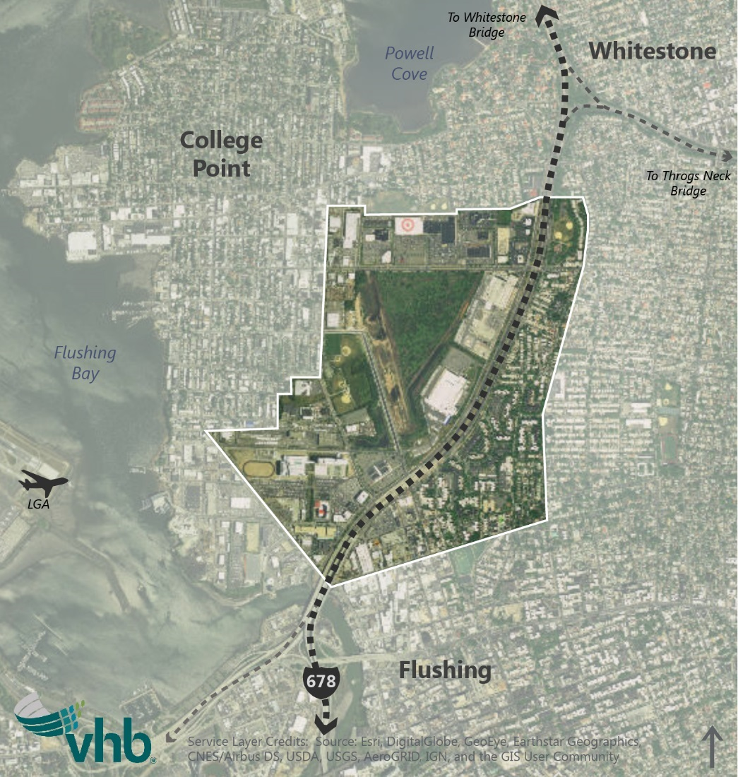
Study Context
The Corporate Park area has outstanding regional highway access via the Whitestone Expressway.
Access is concentrated at the northbound and southbound service roads’ intersections with 20th Avenue and Linden Place.
This study identifies both short and long-term improvements to alleviate congestion and improve infrastructure throughout the College Point Corporate Park area.

Slide 5
Background Overview and Challenges
Transportation
History of congestion at Whitestone Expressway Service Road intersections with 20th Avenue and Linden Place documented back to the College Point Retail EIS (1997)
NYCEDC in conjunction with NYCDOT has implemented significant transportation improvements
Free flowing U-turns under the Whitestone Expressway between College Point Boulevard and Linden Place
Widening of 20th Avenue between the Whitestone Expressway Service Roads and Parsons Boulevard
Linden Place Extension Phase I
Insufficient parking around the NYPD Police Academy

Slide 6
Background Overview and Challenges (continued)
Infrastructure
Deteriorating asphalt and settling throughout the study area have led to significant drainage issues
Localized flooding occurs throughout the study area even during normal storm events
Poor roadway conditions cause wear and tear on vehicles
The MTA College Point Bus Depot has experienced increased operation and maintenance costs due to poor pavement conditions and sinking facilities
Protruding utility manholes are both a nuisance for vehicles and a potential tripping hazard for pedestrians
Uneven settlement creates low points within the roadway pavement, making it difficult for ponding stormwater to make it to existing catch basins

Slide 7
Agency Coordination and Community Engagement
Community engagement was used throughout the project to identify the challenges and opportunities within the study area
A public workshop was held on May 30, 2017 that included local elected officials and community stakeholders
Attended by approximately 30 people
Spring 2017 meetings with…
Councilmember Vallone
College Point Civic & Taxpayers Assoc.
CPCP Advisory Council, Community Board 7
NYPD Police Academy
College Point Board of Trade

Slide 8
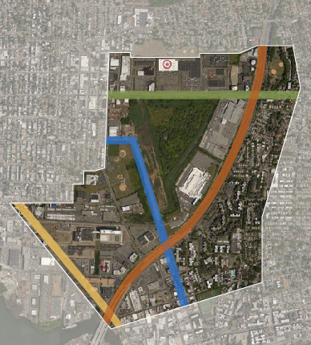
Major Access Routes
20th Avenue
Whitestone Expressway
Linden Place
College Point Boulevard

Slide 9
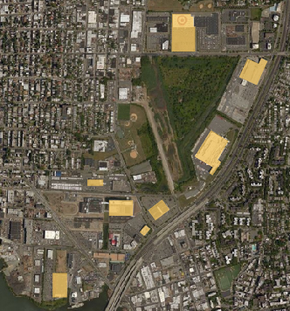
Major Local Traffic Generators
Shopping Center along
20th Avenue (Target/BJs)
USPS Distribution Center
NY Times Distribution Center
MTA Bus Depot
NYPD Police Academy
Triangle Plaza
Department of Motor Vehicles
Home Depot
Note: Each of these developments generate traffic at different times throughout the day.
1
2
3
4
6
5
7
8

Slide 10
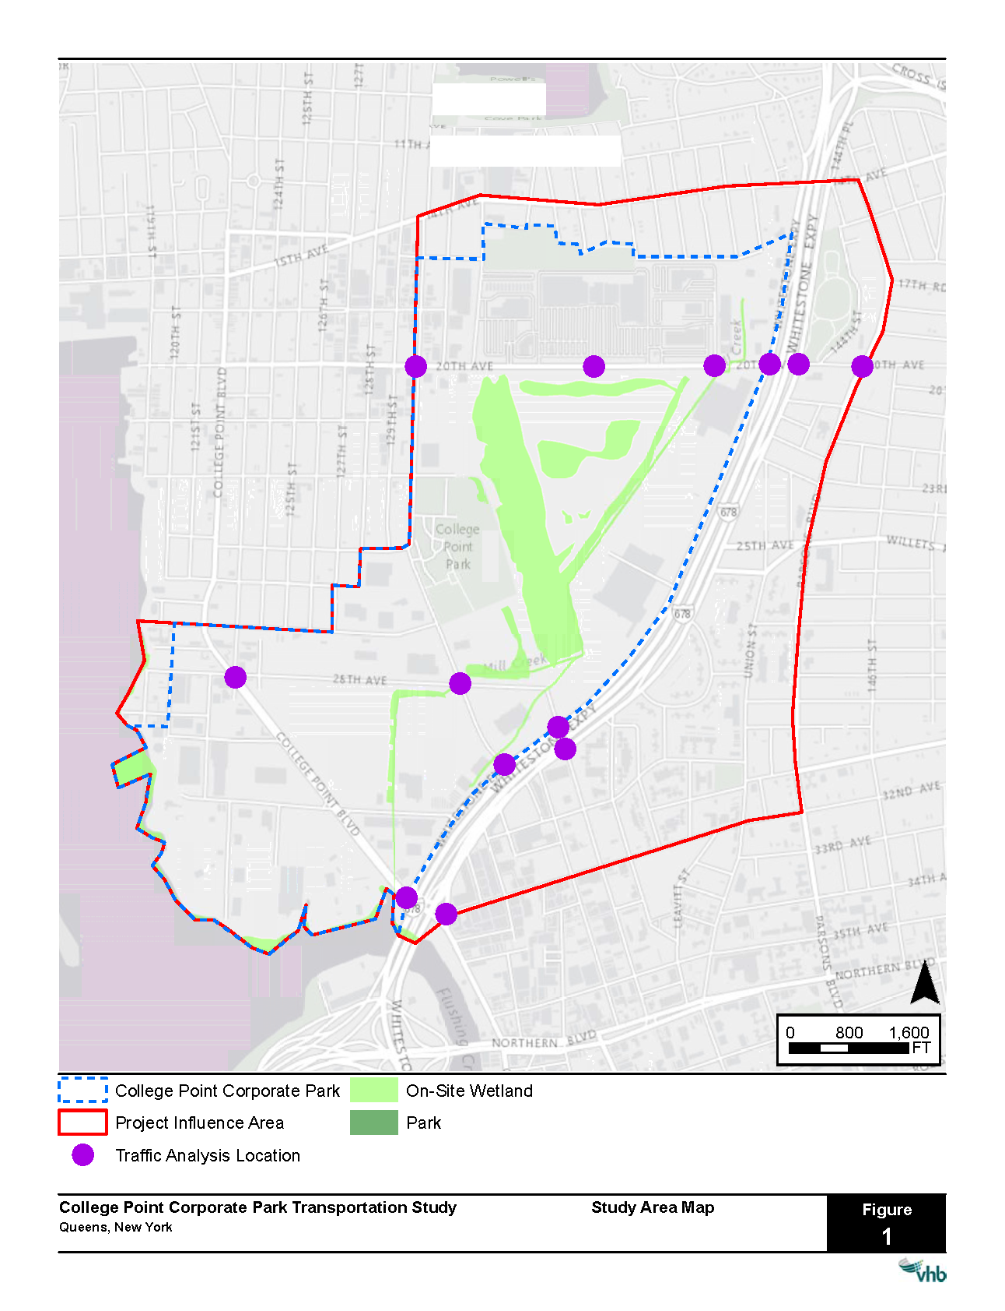
Traffic Analysis Locations
Note: These were the key locations in this study chosen for detailed analysis

Slide 11
Projected Traffic Growth
Existing traffic volumes were increased using a background growth rate of 0.50% per year for the first five years and 0.25% per year for the remaining five years (totaling to approximately 4%)
Projected traffic volumes from two background developments were also included
College Point Sports Complex improvements
P.S. 129
Note: Growth rates are in accordance with the 2014 CEQR Technical Manual guidelines for Queens projects.

Slide 12
Issues and Opportunities – Areawide
Truck traffic and parking
Contributes to congestion
Desire for better enforcement of truck routes and parking regulations
Pedestrian and bicycle safety
Faded crosswalks throughout the study area
20th Avenue and Linden Place intersections with the Service Roads are intimidating for pedestrians
Multi-modal and streetscaping opportunities
Concern for pedestrian safety at new school
Parking throughout the Corporate Park
College Point sports complex parking lot is used by residents for overnight parking
NYPD Police Academy carpooling rules contribute to a lack of parking in the area

Slide 13
Issues and Opportunities – Localized
Ulmer Street and SB Service Road
Poor pavement conditions contribute to delays
New lane configuration planned for SB Ulmer Street approach
Linden Place and Service Roads
Desire for signal timing improvements
Linden Place extension is expected to alleviate congestion and improve north-south connectivity
Auto-only U-turn is expected to reduce volumes at this intersection
20th Avenue and Service Roads
High volume of left turns from the service roads
20th Avenue and 130th Street
Desire for better signage and striping
EB and WB approach and receiving lanes are not aligned
28th Avenue and College Point Boulevard
Complaints of speeding
Pedestrian and bicycle “high-crash” location

Slide 14
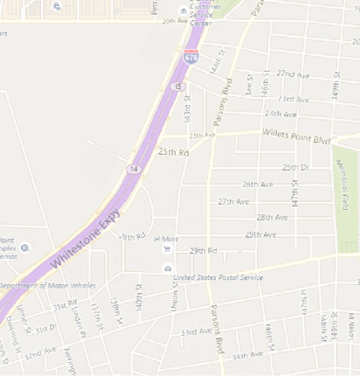
Major Findings – Existing Conditions
Only two of the 13 study intersections operate at unacceptable overall levels of service during any peak hour
20th Ave and SB Service Rd
Ulmer St and SB Service Rd
Delays are generally worse in the AM and PM peak hours
All remaining study intersections operate at acceptable overall levels of service during all weekday and Saturday peak hours analyzed
Note: 2014 CEQR Technical Manual guidelines consider a movement or intersection to be “acceptable” when the average delay is less than or equal to 45 seconds for signalized intersections.
20th Avenue at Whitestone Expressway Southbound Service Road
Ulmer Street at Whitestone Expressway Southbound Service Road

Slide 15
Crash Summary
NYPD crash data was obtained for each of the study locations for the most recent three-year period for which data are available
College Point Boulevard at 28th Avenue/123rd Street is the only high-crash location (per NYCDOT criteria) with five pedestrian/bicycle-related crashes occurring within a 12-month period
No clear trends were identified as to the causes of these crashes
Note: A summary of the NYPD crash data for each study location is provided in Appendix B.

Slide 16
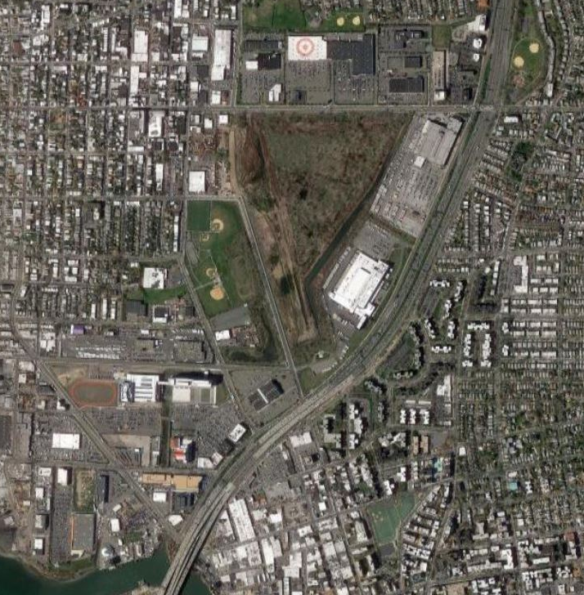
Short-Term Transportation Improvements
Localized
Re-stripe faded crosswalks and lane markings at:
20th Avenue and 130th Street
Linden Place and the Service Roads
College Point Boulevard and 28th Avenue (ped/bike high-crash location)
College Point Boulevard and 32nd Avenue/NB Service Road
Speed trailers at College Point Boulevard and 28th Avenue to deter speeding
Note: NYPD enforcement will be necessary to completely deter speeding.
Restriping
Speed Trailers
Notes:
Aerial

Slide 17
Short-Term Transportation Improvements (cont.)
Localized
Signal timing improvements at:
20th Avenue and Petracca Place
20th Avenue and Service Roads
20th Avenue and Parsons Boulevard
Ulmer Street and SB Service Road
Linden Place and the Service Roads
Stripe formal lanes along the NB Service Road between College Point Boulevard and Linden Place
A left turn prohibition along the SB Service Road at 20th Avenue is recommended, but is dependent on a feasibility analysis
Signal Timing
Restriping
LT Prohibition

Slide 18
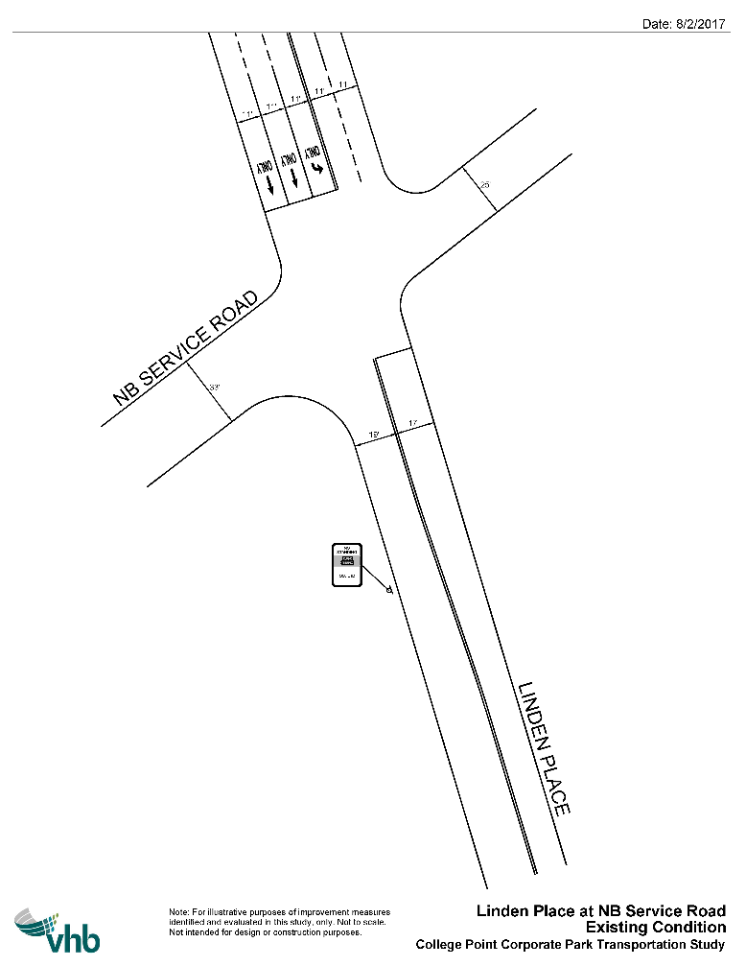
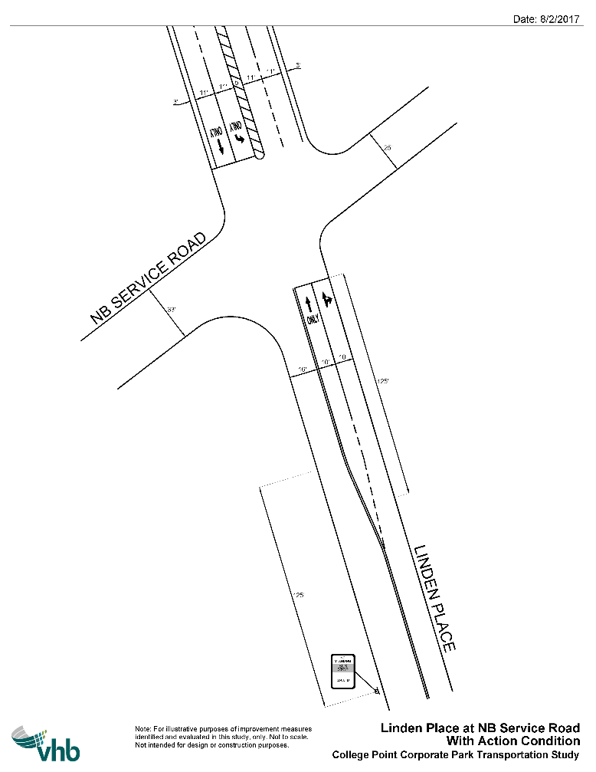
Short-Term Transportation Improvements (cont.) – Linden Place at NB Service Road
Existing:
Proposed:
Restripe EB Linden Place approach to two lanes with a striped median
Restripe WB Linden Place approach to formally provide a second travel lane
Move bus stop 125 feet downstream
Note: See Appendix B for additional details
Notes:
EB Linden Place approach currently functions as two lanes of traffic since the striping under the Whitestone Expressway is barely visible.

Slide 19

Ongoing Transportation Improvements
Areawide
Planned auto-only U-turn along SB Service Road north of Linden Place
Planned Linden Place Extension Phase II
Establish a formal restriping plan for the Corporate Park area
Potential streetscaping opportunities along College Point Boulevard and 20th Avenue
Localized
Planned lane addition to SB Ulmer Street at the SB Service Road
Lane addition to the SB Service Road at 20th Avenue is recommended, but may require NYSDOT involvement
Linden Pl Ext.
U-turn
Add lane

Slide 20
Major Findings – Future Conditions
Congestion still exists primarily at the intersection of 20th Avenue and the SB Service Road; and in the AM peak hour at the intersection of Ulmer Street and the SB Service Road
The Linden Place Extension and auto-only U-turn north of Linden Place improve capacity along Ulmer Street, Linden Place, and the Service Roads by providing more north-south connectivity
The short-term traffic improvements bring many of the traffic movements back to acceptable levels of service and in some cases improve upon the existing conditions
Feedback from the community will be addressed through safety improvements and continued coordination between NYCEDC, NYCDOT, and NYPD

Slide 21
Ongoing Agency Coordination
Consultation with NYPD regarding police academy parking
Monthly NYPD truck enforcement day to deter illegal truck traffic and parking
Meeting with MTA regarding transit in the area
Goal of this meeting would be to identify if there is a clear transit issue in the area and how it can be resolved

Slide 22
Summary of Key Findings - Transportation
Only two of the 13 study intersections operate at unacceptable overall levels of service in the existing conditions (average delay greater than 45 seconds per vehicle)
20th Avenue and SB Service Road
Ulmer Street and SB Service Road
Short-term improvements are able to improve most of the capacity and safety issues in the study area
Short-term improvements include signal timing changes, crosswalk and lane restriping, and installation of speed trailers
The Linden Place Extension and auto-only U-turn improve capacity along Ulmer Street, Linden Place, and the Service Roads
North-south traffic will be diverted from the Service Roads to Linden Place once the extension is complete
The new U-turn will reduce traffic at the intersections of Linden Place with the Service Roads

Slide 23
Summary of Key Findings – Transportation (cont.)
There is one ped/bike high-crash location in the study area
College Point Boulevard and 28th Avenue/123rd Street had five pedestrian/bicycle-related crashes within a 12-month period
No locations surpassed CEQR thresholds for vehicular crashes
Development of a long-term maintenance plan for striping will improve pedestrian and bicycle safety
Several locations in the study area could benefit from restriped crosswalks and lane markings
This would improve safety and clarity for both vehicles and pedestrians

Slide 24
Summary of Key Findings – Transportation (cont.)
Community feedback has shown a concern for truck-related issues and calls for an action plan
Meetings will be held between NYCEDC, NYPD, and local businesses regarding illegal truck activity within the Corporate Park
The SB Service Road at 20th Avenue is the most serious capacity issue and may require a longer-term solution
Prohibiting left-turns from the SB Service Road could provide relief, but would require an analysis of the diverted traffic
Adding a fourth lane to the SB Service Road would also improve capacity, but right-of-way would need to be acquired

Slide 25
Basis of Infrastructure Analysis
2017 Public Workshop Feedback
Site Observations from 2/8/2017
2002 Geotechnical Analysis by Edwards & Kelcey Engineers, Inc (see Appendix C)
8/2/2017 Interagency Meeting between VHB, EDC, & NYCDOT
9/19/2017 Interagency Meeting between VHB, EDC, NYCDOT, NYCDDC, NV5, & Mueser Rutledge Consulting Engineers
Case Study: Linden Place (between 28th & 23rd Ave)
Case Study: 132nd Street Extension (between 23rd & 20th Ave)
Case Study: 28th Ave (between College Point Blvd & Ulmer St)

Slide 26
Key Infrastructure Issues
Poor asphalt conditions
Widespread, uneven settlement
Due to presence of organic and compressible soils (especially where historic wetlands and creek have been filled)
Protruding utilities within roadways and sidewalks
Localized ponding
Majority of the College Point Corporate Park study area is within FEMA’s 100-year and 500-year floodplains

Slide 27
Consequences of Key Infrastructure Issues
Deteriorating asphalt and settling throughout the study area has led to significant drainage issues
Localized flooding occurs area-wide even during normal storm events
Poor roadway conditions cause wear and tear on vehicles
The MTA College Point Bus Depot has experienced increased operation and maintenance costs due to poor pavement conditions and sinking facilities
Protruding utility manholes are both a nuisance for vehicles and a potential tripping hazard for pedestrians
Most access roads through College Point Corporate Park will be inundated in an extreme FEMA flood event since it is within FEMA’s 100- and 500-year floodplains. *
* Per FEMA map, only one route connecting College Point to the rest of the borough (14th Avenue) will be accessible if surrounding area is inundated in an extreme FEMA flood event.

Slide 28
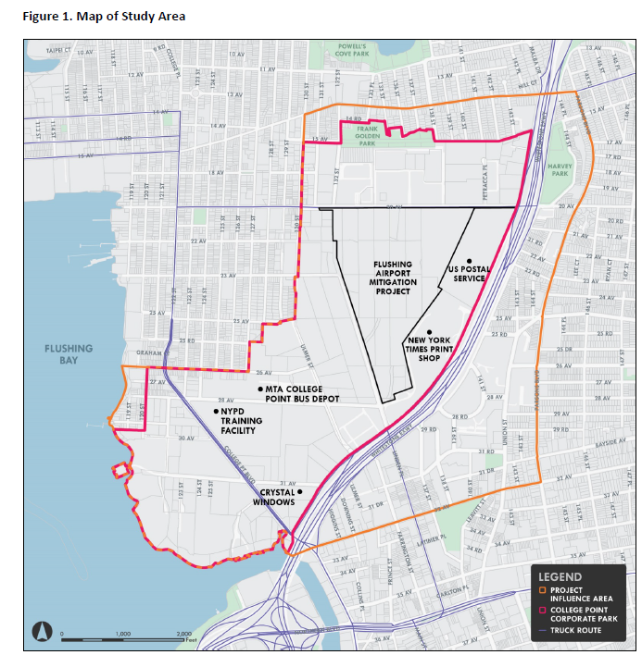
Study Area
124th St
Petracca Pl.
5
20th Ave
4
Whitestone Expy
Linden Pl
26th Ave
1
Ulmer St
28th Ave
2
6
College Pt. Blvd
31st Ave
Photo
Reference
Worst
Conditions
3
#
Notes:
And photo reference of problem areas

Slide 29
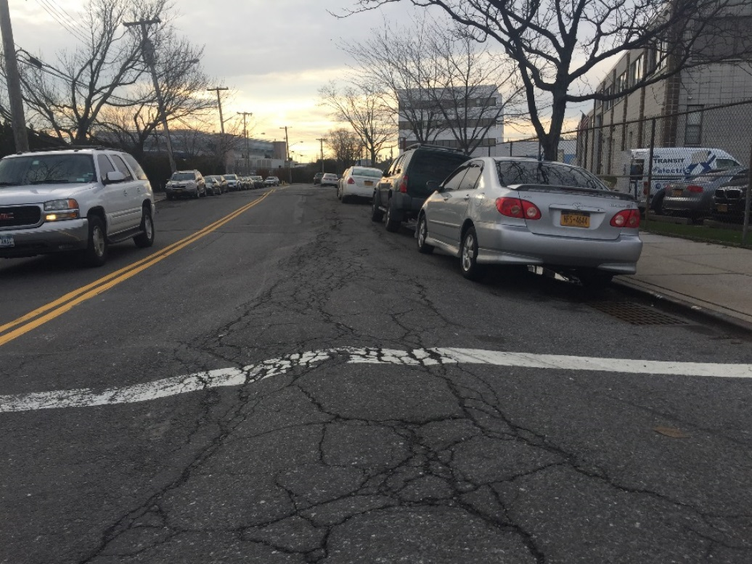
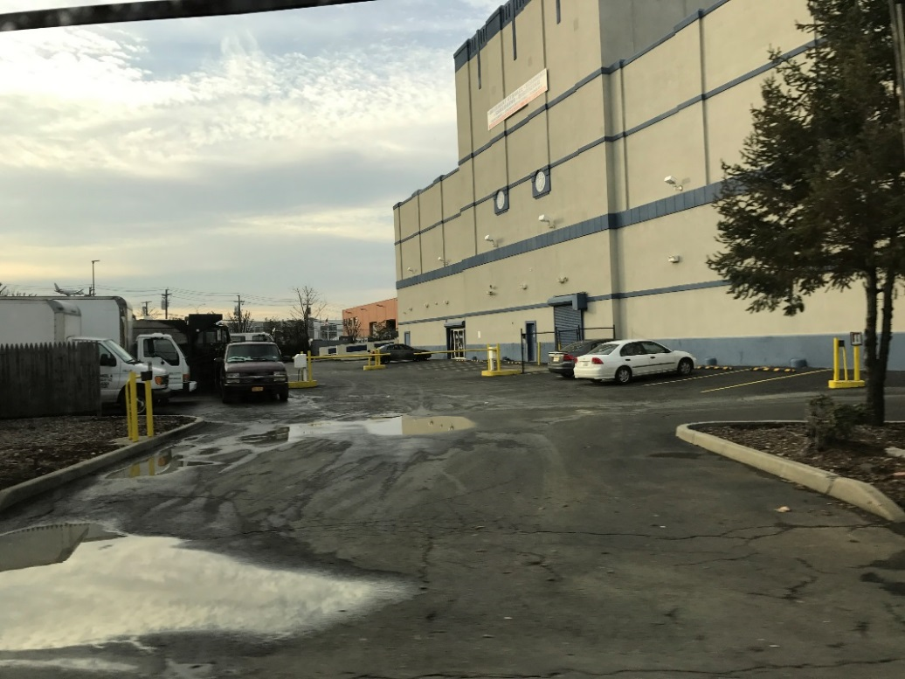
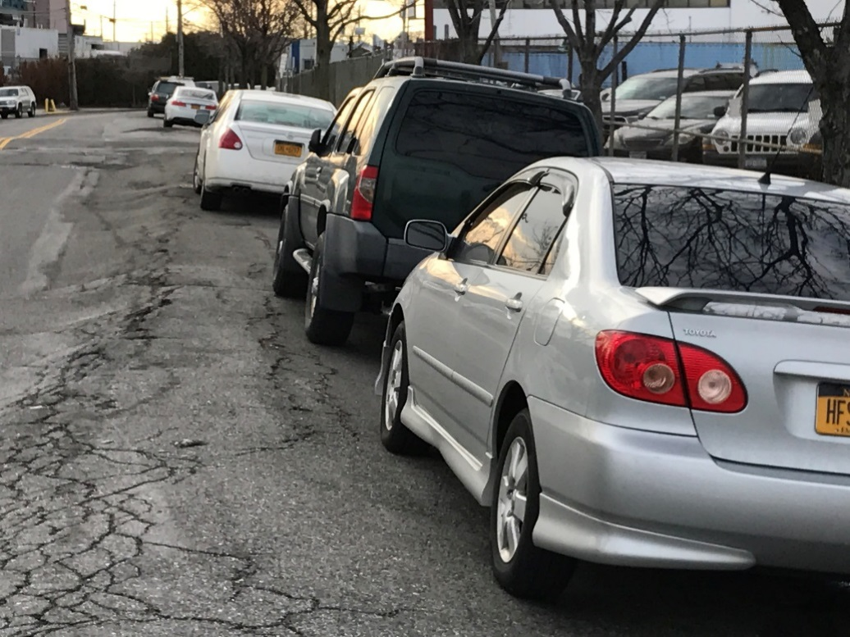
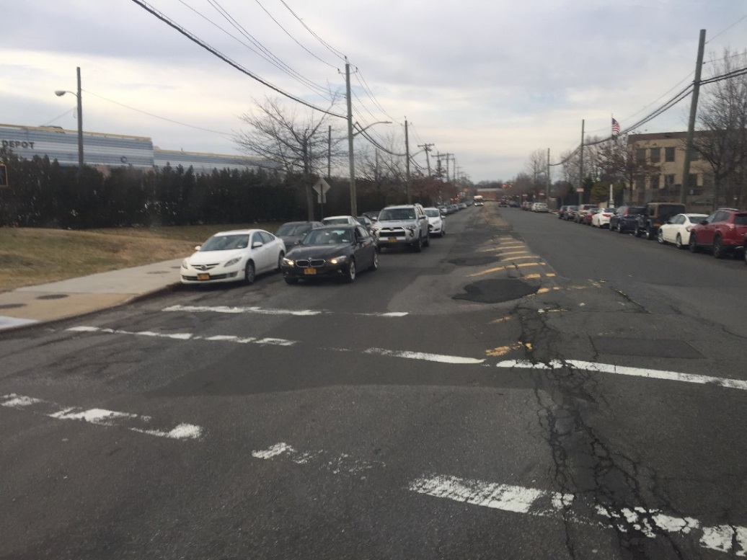
Poor Asphalt Conditions
Ulmer & 26th Ave.
Whitestone Expy Ponding
1
3
Ulmer & 26th Ave.
Ulmer & 28th Ave.
1
2

Slide 30
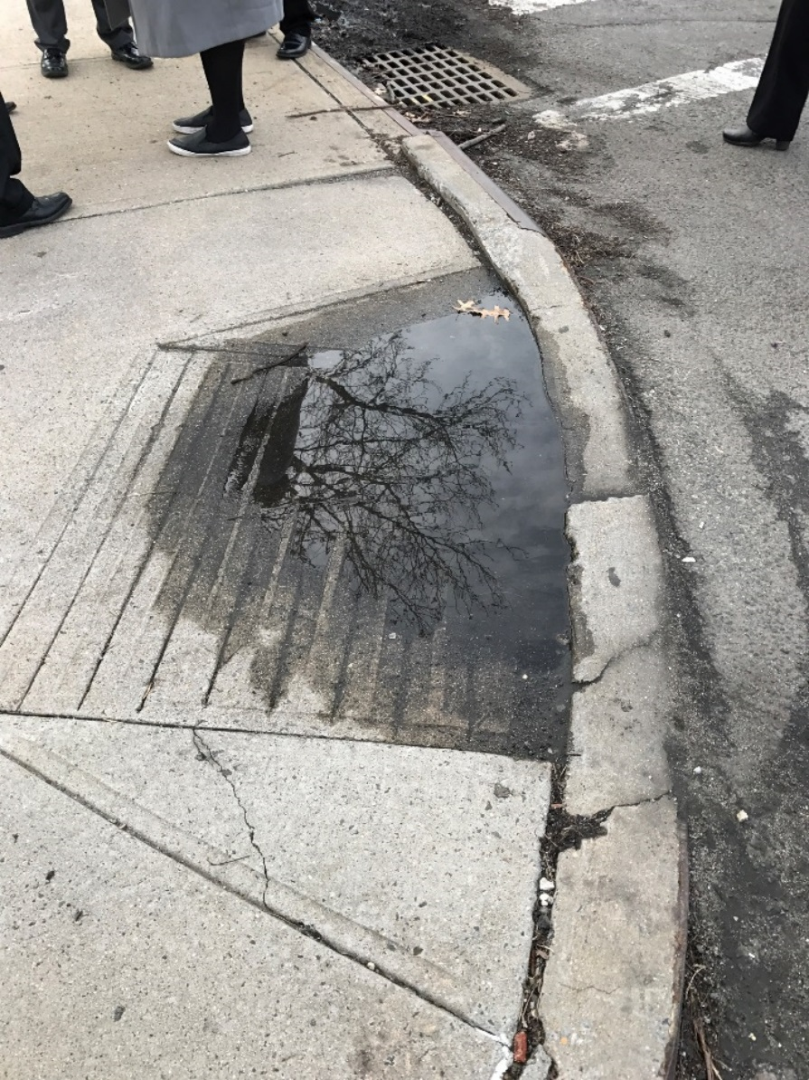
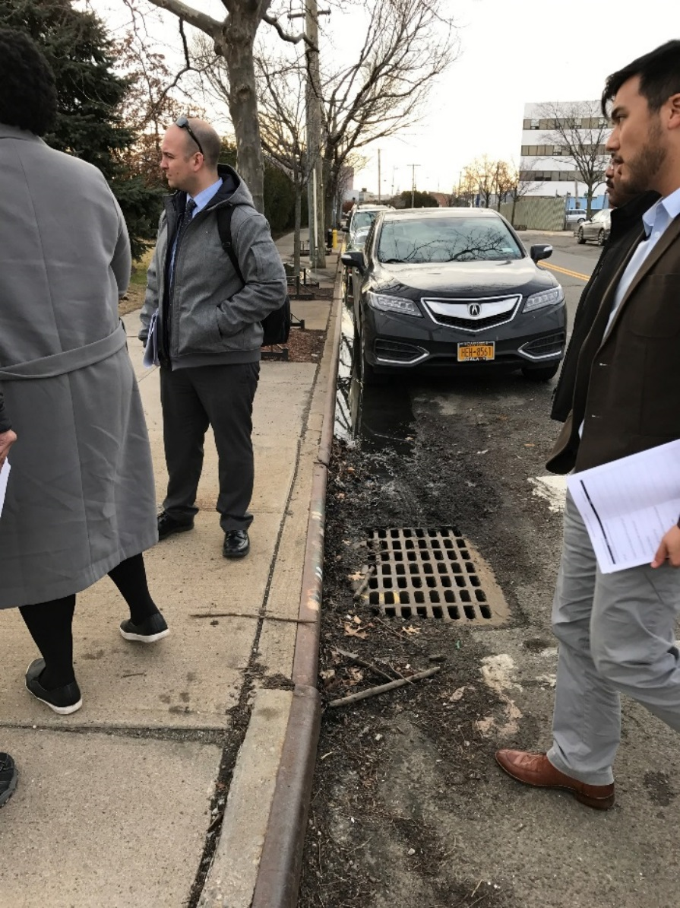
Settlement & Ponding Issues
Ulmer & 26th Ave.
Ulmer & 26th Ave.
1
1

Slide 31
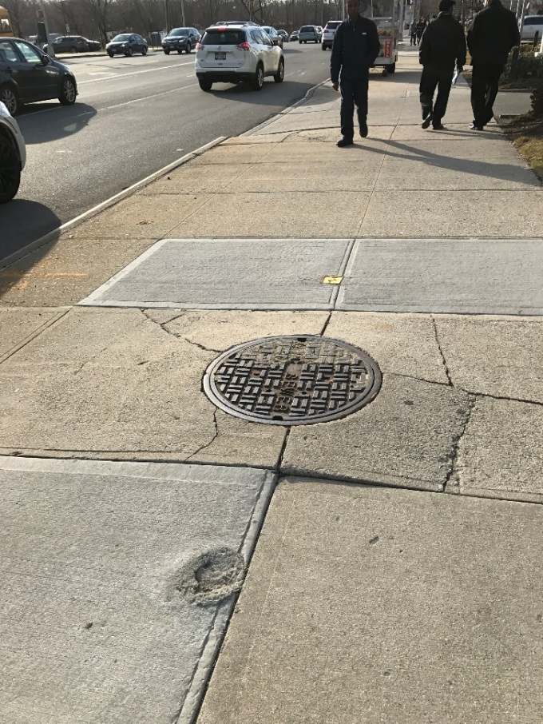
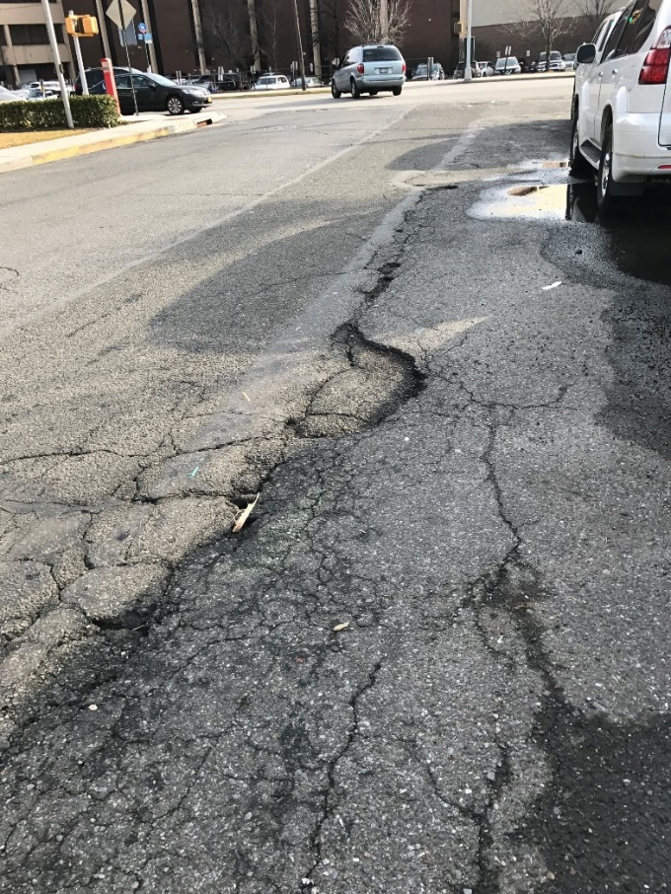
Affected Utilities & Pavement Conditions
20th Ave
Petracca Pl.*
4
5
*Similar issues are occurring on private properties in the surrounding area.

Slide 32
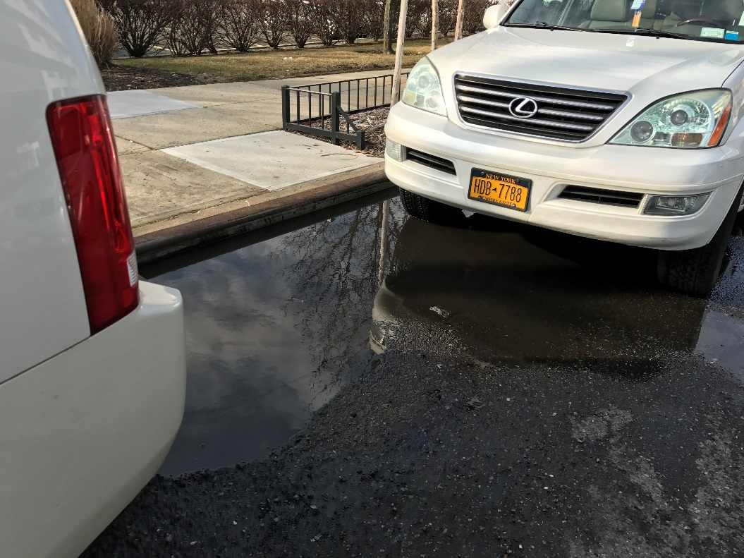
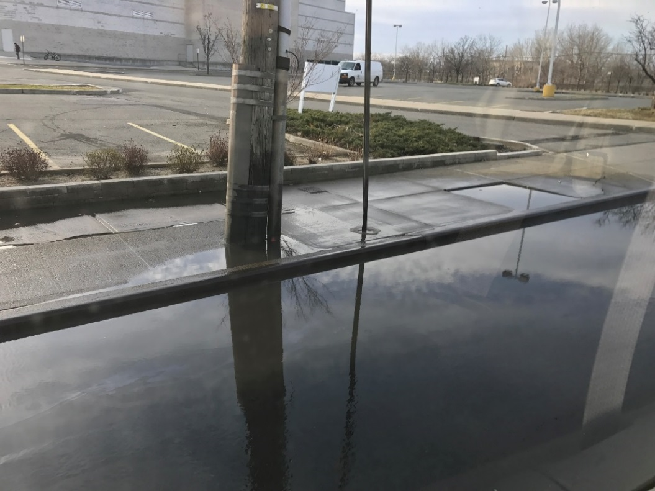
Petracca Pl. Ponding*
Localized Ponding
Multiplex Ponding
5
6
*Similar issues are occurring on private property in the surrounding area.

Slide 33
Possible Causes of Infrastructure Issues
Settlement may be the root cause of the majority of the infrastructure issues.
This is based on 2017 site observations and review of past geotechnical information (2002).
Past geotechnical correspondence (in 2002) shows:
History of settlement
Presence of organic soils
Range of 15 feet to 70 feet of organic materials along 28th Ave. from borings in the 1960s and 1970s
Bedrock is deep
Groundwater is shallow
Sewers are on piles
Historical soil information from past geotechnical studies can help provide further insight on existing and future settlement issues.

Slide 34
Wetlands
Wetland soils tend to have high levels of organic matter.
Organic matter decomposes over time, which results in settlement.
Because of this, chances of settlement are likely higher where historic wetlands have been filled to create urban land.
Petracca Pl.
5
20th Ave
4
124th St
Mill Creek
Whitestone Expy
Linden Pl
26th Ave
Ulmer St
1
28th Ave
2
6
3
Photo
Reference
#

Slide 35
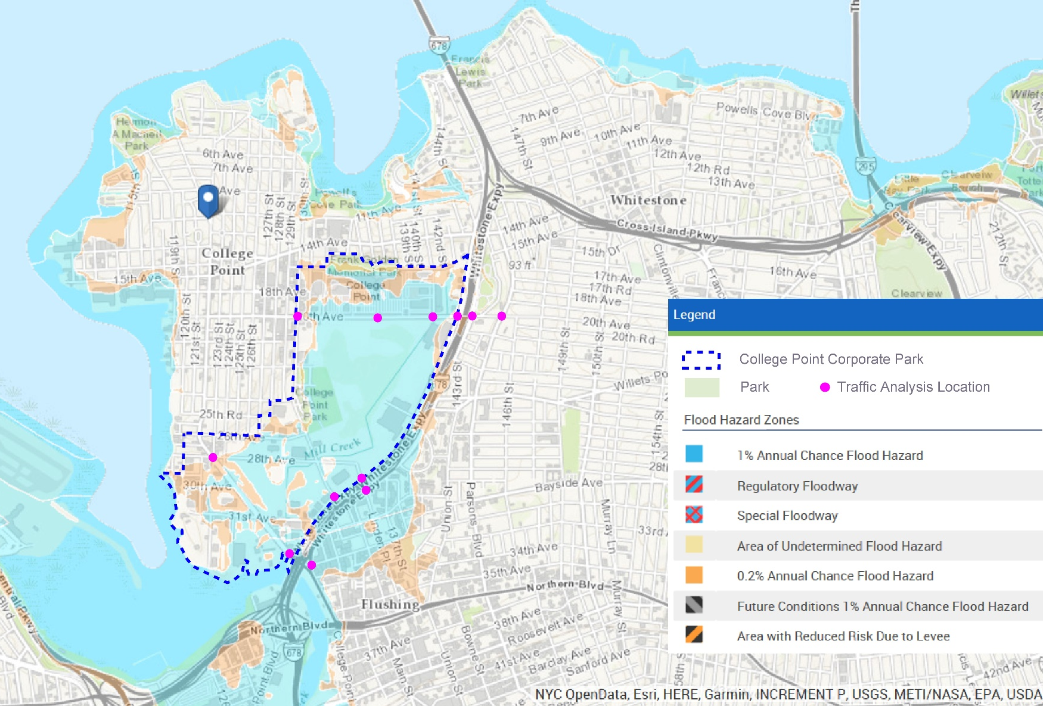
FEMA Floodplains
The natural topography of College Point Corporate Park (CPCP) lends itself to flooding during extreme FEMA flood events, since it is a historic low point consisting of wetlands and a creek, both of which have been partially filled over time.
5
4
Photo Reference from previous slides
4
1
*
2
6
3
*
Source: ASCE 7 Hazard Tool: NYC Open Data, Esri, HERE, Garmin, INCREMENT P, USGS, METI/NASA. Screenshot taken June 21, 2017.
*Note:
The “1% Annual Chance Flood Hazard” is FEMA’s 100-year floodplain as defined in the footnote of Slide 10.
The “0.2% Annual Chance Flood Hazard” is FEMA’s 500-year floodplain as defined in the footnote of Slide 10.

Slide 36
Potential Solutions for…
1. Localized Ponding
See solution 2.A. under “2. Poor Asphalt Roadway Conditions”, since most of this is likely caused by settlement issues and poor roadway conditions.
A routine inspection, cleaning, and maintenance program for catch basins in the area is recommended, if one isn’t already in place. This can be further coordinated with NYCDEP, potential existing and/or future Business Improvement Districts (BIDs) if applicable, and/or other similar interested parties and entities.
Add catch basins or proposed green infrastructure at low points where water is ponding and missing catch basins. (See following slide for samples of green infrastructure solutions, such as right-of-way bioswales.)

Slide 37
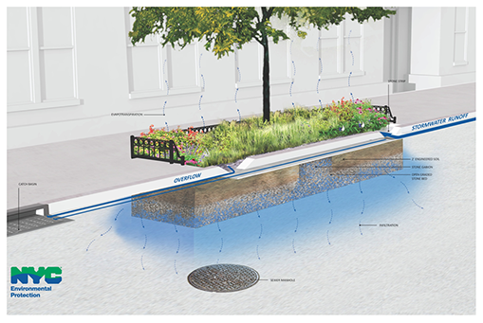
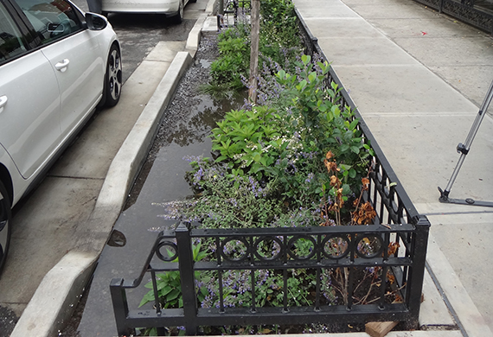
Samples of Short Term Solutions for Localized Ponding
R.O.W. Bioswale
NYCDEP Bioswale

Slide 38
Potential Solutions for…
2. Poor Asphalt Roadway Conditions
Re-grade, mill and pave such that roadways slope towards existing catch basins. Note: This solution may not be feasible since NYCDOT had concerns that frequent milling and paving may increase pressure on gas mains in the College Point Corporate Park area.
For select roadways, reconstruct with a rigid subbase (with hopes that it will help make the settlement more uniform). Periodically mill and pave depending on how long it will take for settlement to be completed.
3. Affected Utilities & Pavement Conditions
Adjust manhole and utility covers to prevent protrusions that may be a hazard for pedestrians and/or vehicles

Slide 39
Potential Solutions for…
4. Settlement Issue
Long term maintenance plan: Implement a phased consolidation scheme for each of the roadways with detours in place for the phase consolidation to happen over time. Can implement a pilot program for one section of roadway first to determine effectiveness of solution. Soils from past geotechnical reports and findings indicate presence of varying levels and amounts of organics, depending on location.
Further subsurface investigation of soil conditions is recommended to obtain a more comprehensive understanding of the widespread settlement issue.
For other long term solutions, see following slide and findings from geotechnical analysis performed by Edwards and Kelcey Engineers, Inc. in 2002 and 2003, in Appendix C.

Slide 40
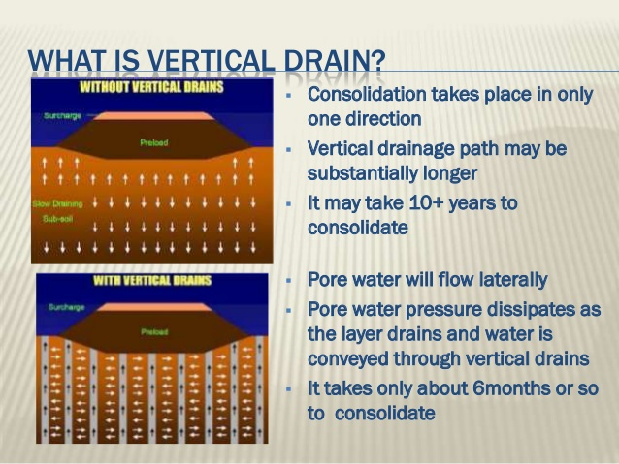
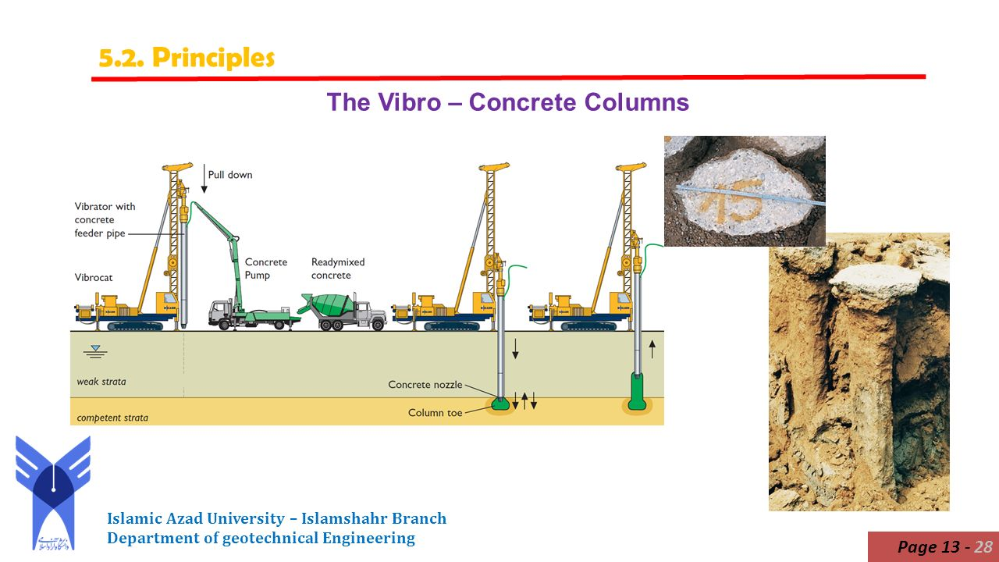
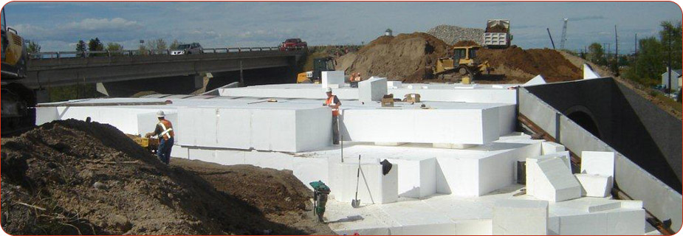
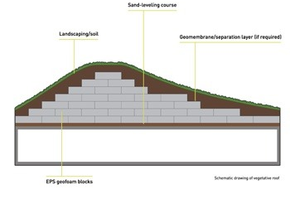
Samples of Long Term Solutions for Settlement by E&K
Surcharge w/ wick drains
Vibro Concrete Columns
Geofoam
NOTE: See following slide for descriptions of the above long-term solution samples.
Notes:
Source:
Vibro Concrete Columns:
https://www.google.com/search?q=vibroconcrete+columns&source=lnms&tbm=isch&sa=X&ved=0ahUKEwj97tPT4LfVAhXIKyYKHWiEArUQ_AUIBygC&biw=1305&bih=682#imgrc=kytZMup-RGVlAM:&spf=1501649596779
Geofoam:
https://www.google.com/search?q=geofoam+fill&source=lnms&tbm=isch&sa=X&ved=0ahUKEwiv3Mrl3rfVAhWGQiYKHXSWAhMQ_AUIBygC&biw=1305&bih=682#imgrc=od-n14Q4n4UctM:&spf=1501649093001
Surcharge with Wick Drains:
https://www.google.com/search?q=surcharging+with+wick+drains&tbm=isch&tbo=u&source=univ&sa=X&ved=0ahUKEwi1xZ7lzbjVAhVGOyYKHckNCs0QsAQIMA&biw=1296&bih=682#imgdii=BM2Dsykg1a168M:&imgrc=dhNcJKxif8j4nM:&spf=1501678893643

Slide 41
Samples of Long Term Solutions for Settlement by E&K (cont.)
Surcharge with Wick Drains
A surcharge load is placed over compressible soils; the weight of the surcharge helps to accelerate soil consolidation
A prefabricated vertical drain system (consisting of wick drains spaced at pre-determined intervals) is installed in the soil to accelerate consolidation by providing drainage paths for porewater to escape
Vibro Concrete Columns
Installation of vibro concrete columns with a “load transfer mat” in lieu of conventional piles and reinforced concrete slab allows for easier access to utilities for long-term maintenance
Vibro concrete columns consist of a 2 to 3 foot unreinforced concrete shaft belled at the top and bottom to 5 or 6 feet to increase the bearing area
“Load transfer mat” consisting of alternating layers of compacted fill and geogrid is constructed above the vibro concrete columns
GeoFoam
GeoFoam is the generic name for expanded polystyrene (EPS) blocks that are used in construction applications as extremely lightweight fill
Used to raise grades above compressible organic deposits

Slide 42
Summary of Key Findings - Infrastructure
Issues | Short Term Solutions | Long Term Solutions
Localized Flooding:
Linden Pl (between Whitestone Expressway and 28th Ave) 28th Ave (between Linden Pl and Ulmer St) Ulmer St (from Multiplex Cinemas to 25th Ave) 23rd Ave (between 130th St and Linden Pl) & 130th St (between 23rd Ave and 25th Ave) (adjacent to ball fields) | Re-grading at intersections and areas experiencing localized ponding to create positive drainage to existing catch basins Installation of catch basins Installation of green infrastructure techniques such as bioswales, permeable pavers | See Long Term Solutions for “Poor Roadway Conditions”
Poor Roadway Conditions:
Ulmer St (between Whitestone Expressway and 23rd Ave) & intersection at 26th Ave 28th Ave (between Linden Pl and College Point Blvd; worst between Linden Pl & Ulmer St) | Enforcement of truck routes Adjust manholes to be flush with ground to remove tripping hazards and protrusions Reconstruction of streets with rigid base | Overconsolidation of soils See geotechnical analysis for other long term solutions proposed by Edwards & Kelcey, Inc. in 2002

Slide 43
Appendix A – Community Outreach

Slide 44
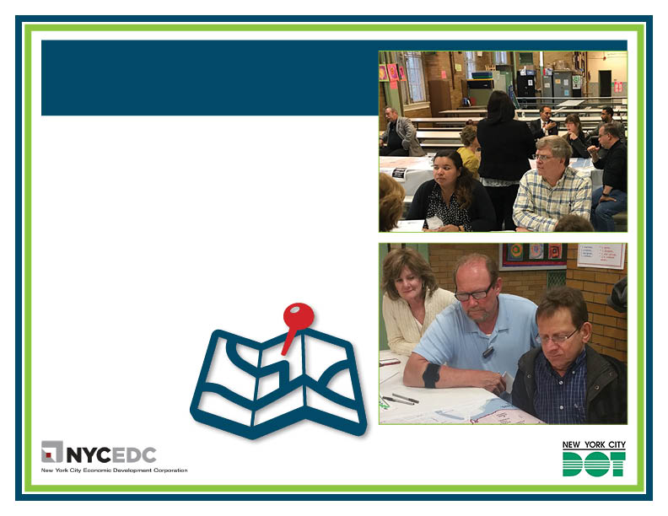
^{COLLEGE POINT CORPORATE PARK}
TRANSPORTATION IMPROVEMENT STUDY APPENDIX A: OUTREACH AND ENGAGEMENT
To ensure that the roadway network keeps pace with CPCP’s diverse needs, NYCEDC and NYCDOT are analyzing street functions/traffic patterns and identifying and prioritizing necessary, feasible improvements to create an integrated transportation plan that will achieve efficiency, accessibility, and better road conditions.
NYCEDC and NYCDOT have reached out to the community and surrounding areas using a variety of outreach forums to gain valuable feedback into the Corporate Park’s needs, including a public workshop and several one-on-one meetings with:
^{Local elected officials}
^{College Point Corporate Park} ^{Advisory Board}
^{NYPD Police Academy}
^{NY Times}
^{Community Board 7}
^{College Point Board of Trade}
^{College Point Civic and} ^{Taxpayers Association}
^{MTA}
^{College Point Businesses}
^{Con Edison}
^{Greater Whitestone Taxpayers} ^{Civic Association}

Slide 45
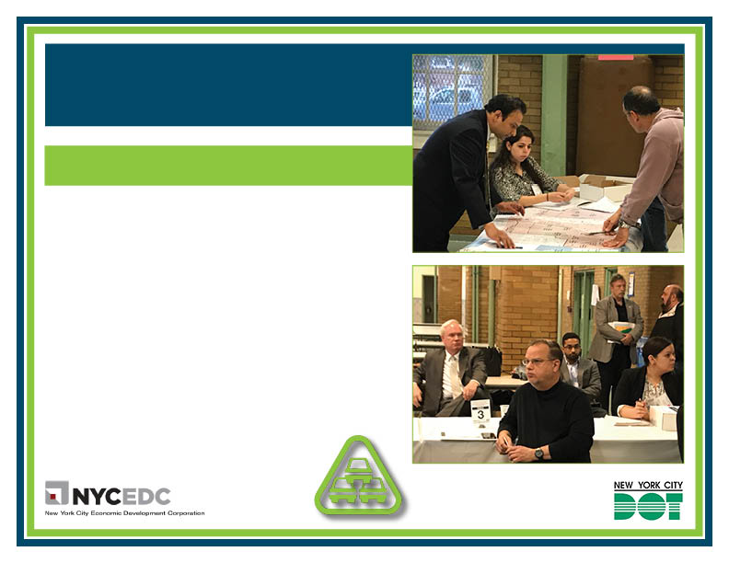
^{COLLEGE POINT CORPORATE PARK}
TRANSPORTATION IMPROVEMENT STUDY APPENDIX A: OUTREACH AND ENGAGEMENT
SHORT-TERM ISSUES: WHAT WE LEARNED ^{FROM YOUR FEEDBACK}
^{DESIGNATED TRUCK ROUTES}
Residents request ways to keep commercial vehicles out of residential communities
Signage at NYT printing facility guides trucks to the southern parking lot entrance, which may be impacting the number of trucks seen along the SB Service Road
College Point Boulevard signage is confusing for truck routes
123rd Street sees truck traffic all day
ENFORCEMENT OF TRAFFIC REGULATIONS
The need for stricter enforcement of “no double parking” regulations
Abandoned vehicles along 25th Avenue
Drivers making illegal turns into Police Academy
Many cited illegal parking by tractor trailers in a number of locations:
^{- Local cinema}
^{- Jetro Cash ‘n’ Carry}
- 132nd Street between 14th Avenue and 20th Avenue
- College Point Sports Complex at 23rd Avenue

Slide 46
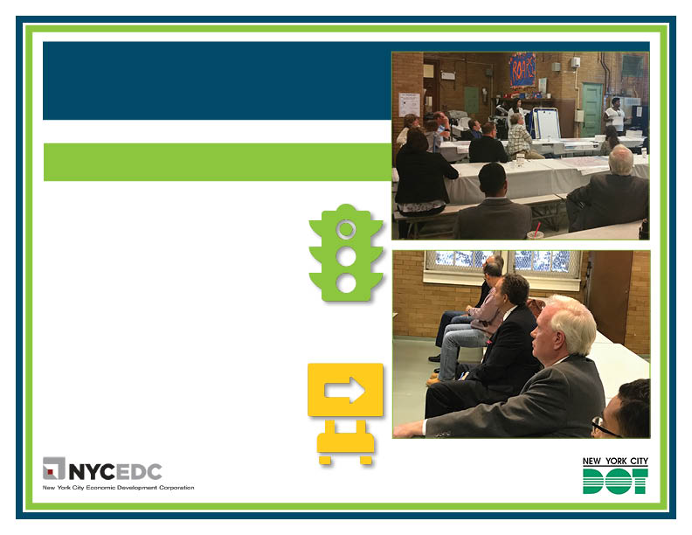
^{COLLEGE POINT CORPORATE PARK}
TRANSPORTATION IMPROVEMENT STUDY APPENDIX A: OUTREACH AND ENGAGEMENT
SHORT-TERM ISSUES: WHAT WE LEARNED ^{FROM YOUR FEEDBACK}
TRAFFIC LIGHTS AND TURN SIGNALS
Feedback has shown the desire for traffic lights at certain locations in the study area
^{- 25th Avenue and 130th Street}
There is a need for more traffic lights to include turn signals and for the signal timing of certain traffic lights to be revised
- Linden Boulevard and Whitestone Expressway Service Road
- College Point Boulevard and 32nd Avenue
^{- 20th Avenue and 130th Street}
^{- 20th Avenue and 132nd Street}
^{- 14th Avenue and 132nd Street}
^{SIGNAGE}
Signage that was deemed lacking or inadequate included lane demarcations and other traffic direction indicators painted on the roadway.
Vehicles ignore the existing stop sign at 25th Avenue and 130th Street

Slide 47
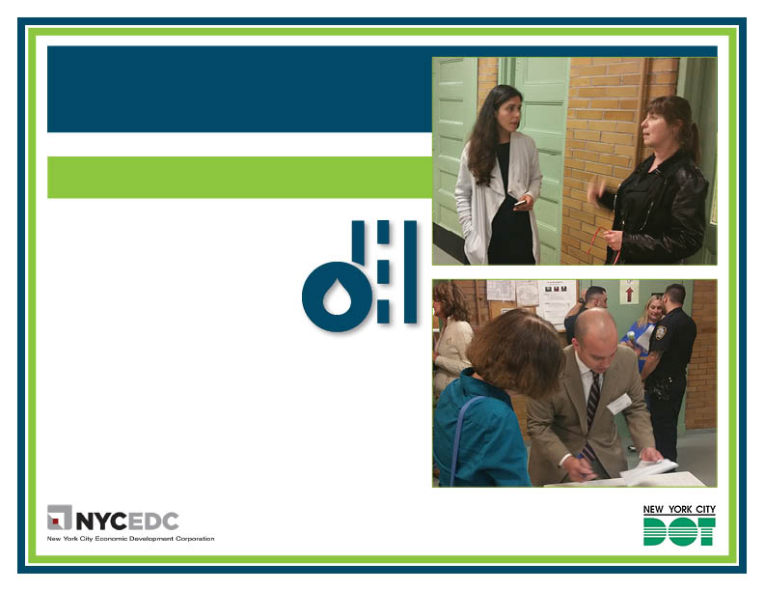
^{COLLEGE POINT CORPORATE PARK}
TRANSPORTATION IMPROVEMENT STUDY APPENDIX A: OUTREACH AND ENGAGEMENT
^{COLLEGE POINT CORPORATE PARK}
TRANSPORTATION IMPROVEMENT STUDY APPENDIX A: OUTREACH AND ENGAGEMENT
LONG-TERM ISSUES: WHAT WE LEARNED ^{FROM YOUR FEEDBACK}
LONG-TERM ISSUES: WHAT WE LEARNED ^{FROM YOUR FEEDBACK}
^{FLOODING}
Perpetual flooding on Ulmer Street in the vicinity of 23rd Avenue should be made a priority
There is road damage caused by the flooding on Ulmer Street, which overlays an underground stream
Damage includes bumps in the road caused by settling underneath the street which slows traffic and areas where the road is sinking
Raising the grade of roadways to conform to the sea-level rise was cited as a way to reduce flooding in the long-term
^{Flooding occurs at:}
- Linden Place between Whitestone Expwy and 28th Avenue
- 28th Avenue between Linden Place and Ulmer Street
- Ulmer Street from Multiplex Cinemas to 25th Avenue
- 23rd Avenue between 130th Street and Linden Place) & 130th Street between 23rd Avenue and 25th Avenue (adjacent to ball fields)
- 20th Avenue (between Whitestone Expwy and 130th Street)
^{INFRASTRUCTURE REPAIRS}
Repair of damaged roadways should be a long-term priority
Extensive damage to roadways in the Study area caused mainly by heavy volumes of truck traffic, potholes, and flooding.

Slide 48
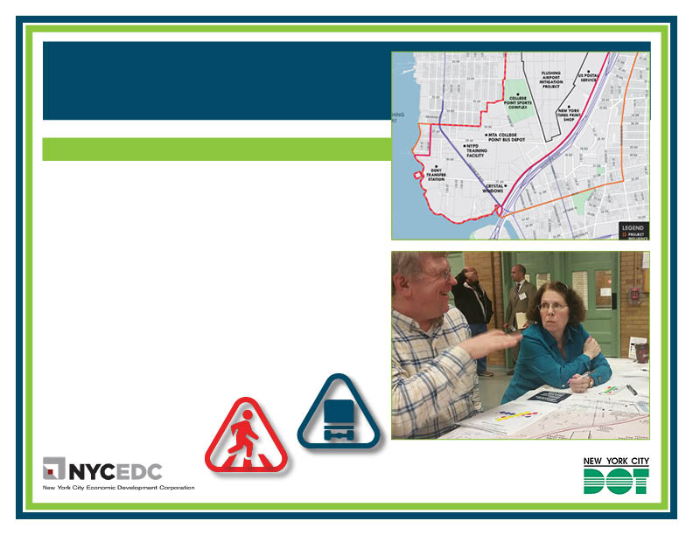
^{COLLEGE POINT CORPORATE PARK}
TRANSPORTATION IMPROVEMENT STUDY APPENDIX A: OUTREACH AND ENGAGEMENT
^{AREA-WIDE ISSUES}
Based on feedback given by members of the public and other stakeholders, the following were identified as the major issues affecting transportation in and around the CPCP:
Illegal truck traffic. Trucks that venture out of designated truck routes are seen as a major contributor to traffic congestion in the Study area.
Illegal truck parking. Attendees cited widespread illegal truck parking and noted that more signage denoting “no double parking” and stricter enforcement of regulations could help alleviate the situation.
Pedestrian and bicycle safety. Faded crosswalk markers, heavy truck volume, and traffic congestion were cited as threats to pedestrian and cyclists’ safety.
Parking. Participants noted the lack of sufficient parking for NYPD Police Academy cadets. Also, NYPD Academy carpooling rules contribute to a lack of parking in the area.
Insufficient public transit. Inadequate public transit in the Study area was seen as a contributor to traffic congestion, with Study leaders called on to include analysis of public transit options in the Study.

Slide 49
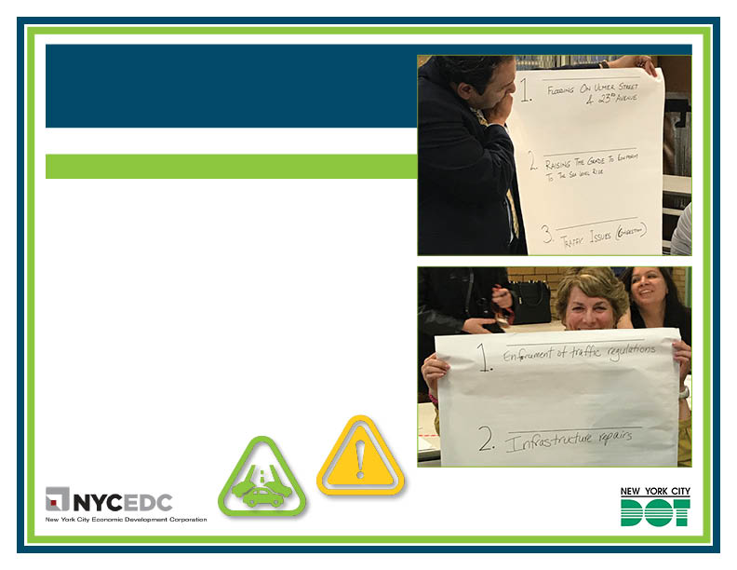
^{COLLEGE POINT CORPORATE PARK}
TRANSPORTATION IMPROVEMENT STUDY APPENDIX A: OUTREACH AND ENGAGEMENT
^{LOCATION-SPECIFIC ISSUES}
Based on feedback given by members of the public and other stakeholders, the following were identified as the major issues affecting transportation in and around the CPCP:
Ulmer Street and SB Service Road. Issues to be addressed include traffic congestion, traffic delays caused by poor pavement conditions along Ulmer Street, and problems with lane configuration on the Ulmer Street approach.
Linden Place and Service Roads. Congestion was cited as a problem here, along with the need for improvements in traffic signal timing.
20th Avenue and Service Roads. This was cited as another area of traffic congestion. The high volume of left turns made from the service roads was seen as a problem that should be addressed.
20th Avenue and 130th Street. According to feedback, better signage and striping is needed here and the east-bound and west-bound approaches and receiving lines are not aligned properly.
28th Avenue and College Point Boulevard. This area has a high level of complaints about speeding and is viewed as a “high-crash” location for pedestrians and bicyclists. Also, “confusing for trucks along 123rd St.”

Slide 50
Responses to Community Feedback
Requests for Left-Turn Signals
College Point Boulevard and 32nd Avenue
Left turning volumes do not appear high enough to warrant a left-turn phase
20th Avenue and 130th Street
Linden Place extension should improve the WB left-turn at this intersection
20th Avenue and 132nd Street
This would require additional study
14th Avenue and 132nd Street
This would require additional study
Requests to Expand NYPD Enforcement
Stop signs at 25th Avenue and 130th Street
Abandoned vehicles along 25th Avenue
Overnight parking at the College Point Sports Complex

Slide 51
Appendix B – Detailed Traffic Analyses

Slide 52
Previous Studies and Correspondence Reviewed
2006 College Point Transportation Study
http://www.nyc.gov/html/dot/downloads/pdf/2006-12-college-point-trans-study.pdf
2010 College Point Transportation Study
http://www.nyc.gov/html/dot/downloads/pdf/2010_college_point_study.pdf
2009 NYPD Academy FEIS
Linden Place Reconstruction Traffic Study
1997 College Point Retail EIS
Letters from the community and elected officials

Slide 53
INSERT TRANSPORTATION APPENDIX

Slide 54
Appendix C – Geotechnical References

Slide 55
2002 Geotechnical Analysis by E&K
The following items were referenced from the 2002 Geotechnical Analysis by Edwards & Kelcey Engineers, Inc
Memorandum of Findings
Comparison Table of Solutions & Cost for Reconstruction of 28th Ave. (between Ulmer St. & 124th St.)
Question & Answers

Slide 56
INSERT INFRASTRUCTURE APPENDIX

